Slide 1
AQE PROJECT
Amit Kumar (201349) UNIT-PERFORMANCE TEST ENGINEER

Slide 2
ABOUT PROJECT
This is a web page testing project.
Technology Used:
HTML
CSS
SELENIUM
TestNg
ECLIPSE

Slide 3
SELENIUM
Selenium is an open-source software framework commonly used for automating web browsers.
It provides a suite of tools and libraries that enable developers to interact with web applications and perform various tasks programmatically, such as:
Web Testing
Web Scraping
Cross-Browser Testing
Support for Multiple Programming Languages
Integration with Testing Frameworks
Browser Automation

Slide 4
Testng
TestNG (Test Next Generation) is an open-source testing framework for Java that is primarily used for test automation.
Here are some key features and concepts associated with TestNG:
Annotations
Test Suites
Parameterization
Dependency Testing
Parallel Execution
Test Configuration

Slide 5
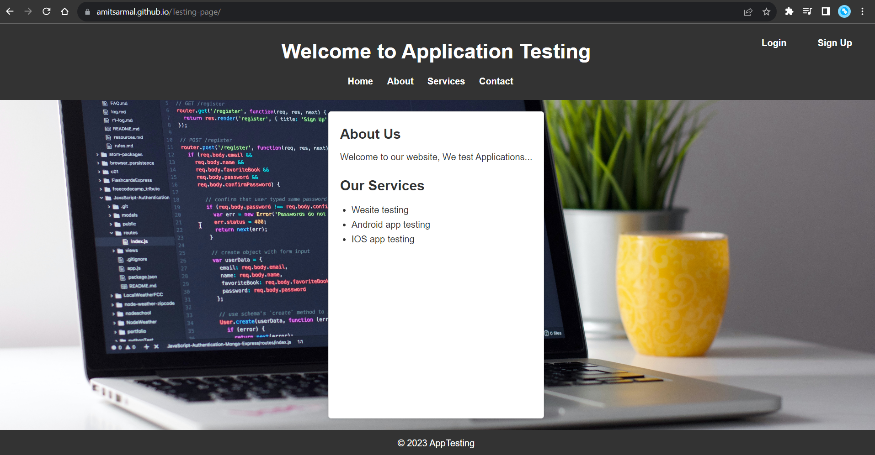
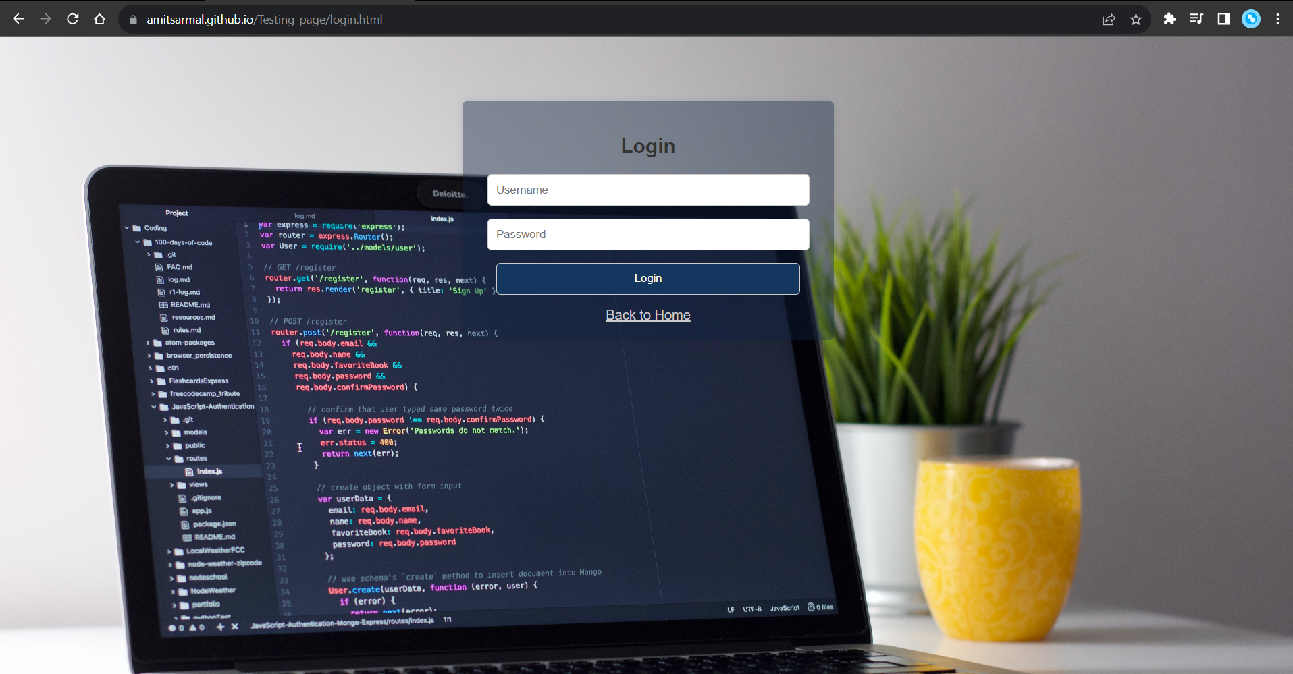
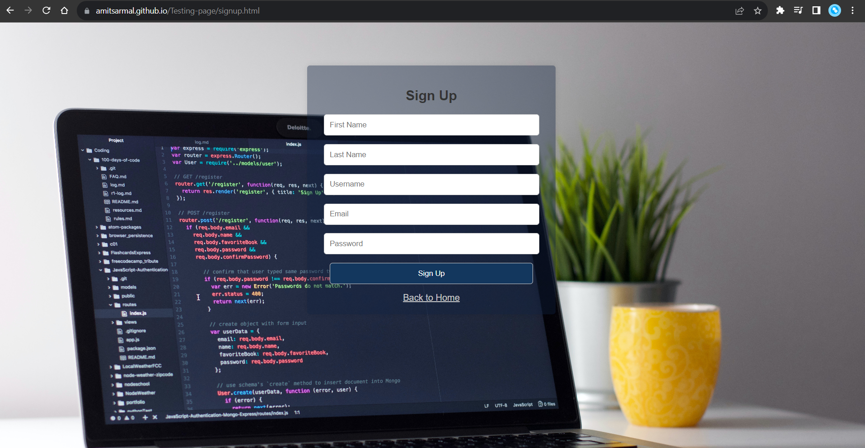
Web-pages

Slide 6
HOMEPAGE TESTING
In home page, we are testing:
Title
Login-Button
Signup-Button

Slide 7
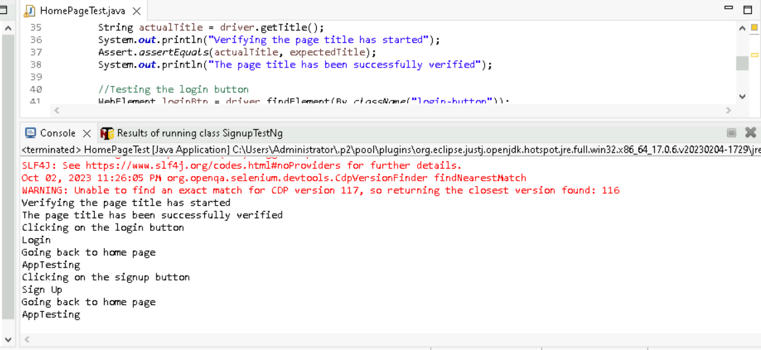
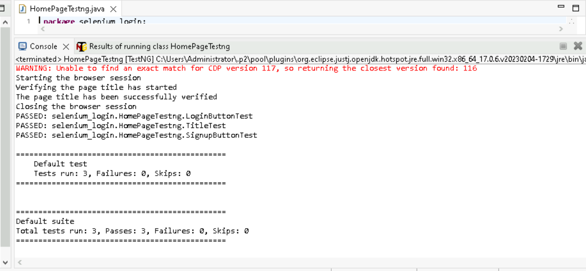
Testing with Selenium
Testing with TestNg

Slide 8
Signup TESTING
In Signup page, we are testing:
Title
Signup-Form
Signup-Button
Back to home button

Slide 9
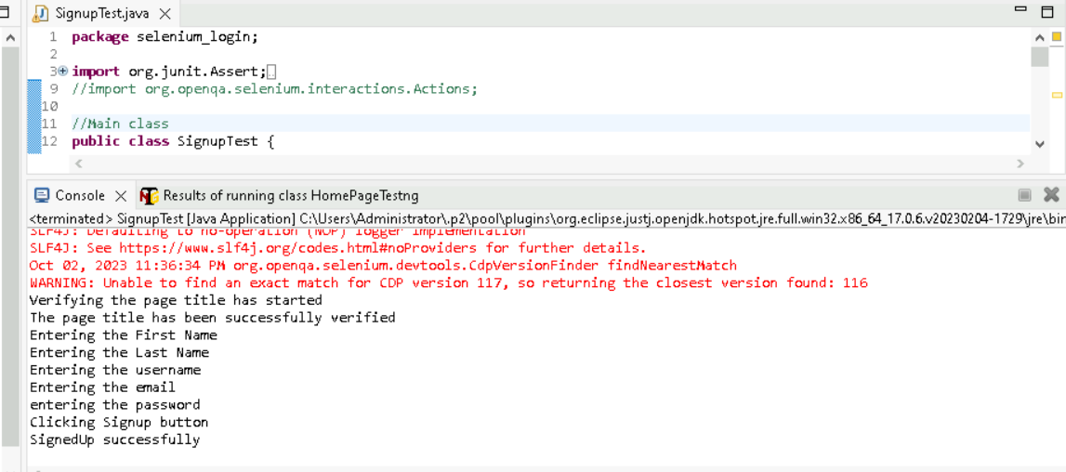
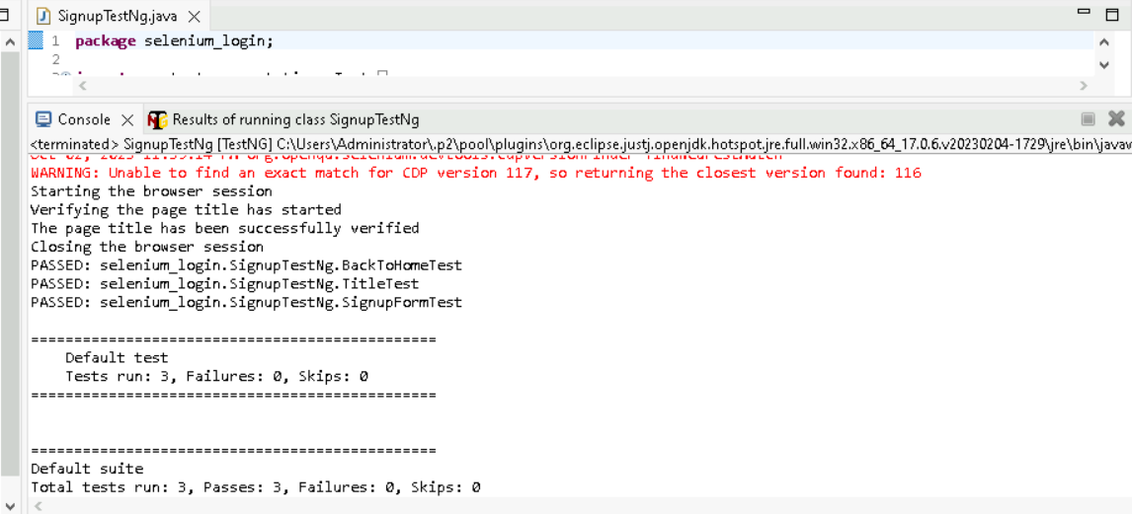
Testing with Selenium
Testing with TestNg

Slide 10
Login TESTING
In Login page, we are testing:
Title
Login-Form
Login-Button
Back to home button

Slide 11
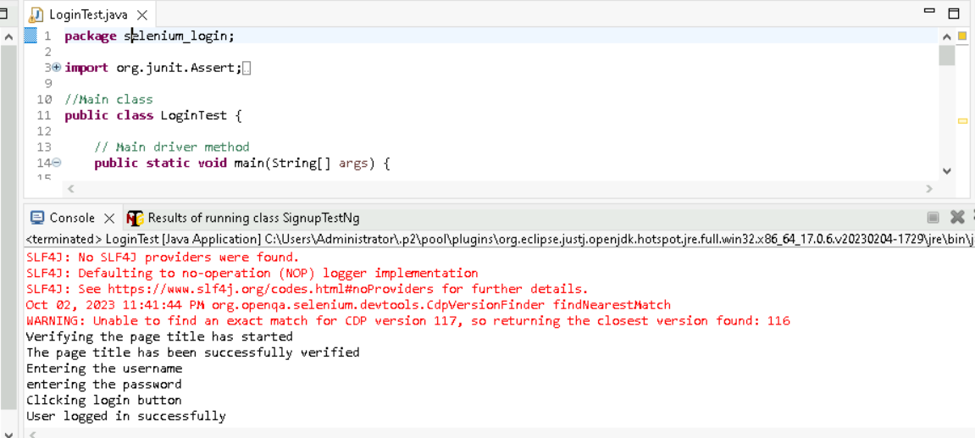
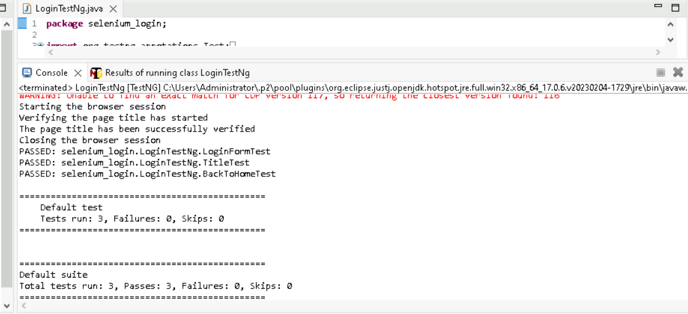
Testing with Selenium
Testing with TestNg

Slide 12
THANK YOU

